Slide 1
Spec Driven Development
The Agentic Mindset
David Berger
Rapido Team · 2026

Slide 2
Agenda
1
Theory
4
Why is it worth it?
incl. 1.5 · Meet our SDLC agent
2
Mission-Brief.md
5
Coming soon
3
Plan.md
Real life example: Email Processing III

Slide 3
Part 1
Theory

Slide 4
Waterfall · 1970
Requirements
Design
Build
Test
One way. No going back.
Deploy

Slide 5
Agile · 2001
Plan
Code > Docs
Adapt
Build
Just start. Adapt.
Review

Slide 6
2023 · LLMs write the code
2023
AI
</>
So… what changes?

Slide 7
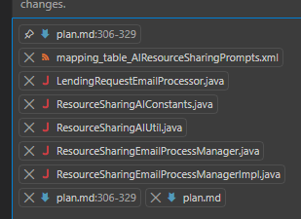


AI code ≠ Agile code
LESSON 1
LESSON 2
LESSON 3
Code is cheap
human language is valuable
Context is critical
Notes:
[Sources]
User-supplied image for code. AI-generated conceptual images for documentation and context connections.
[/Sources]

Slide 8
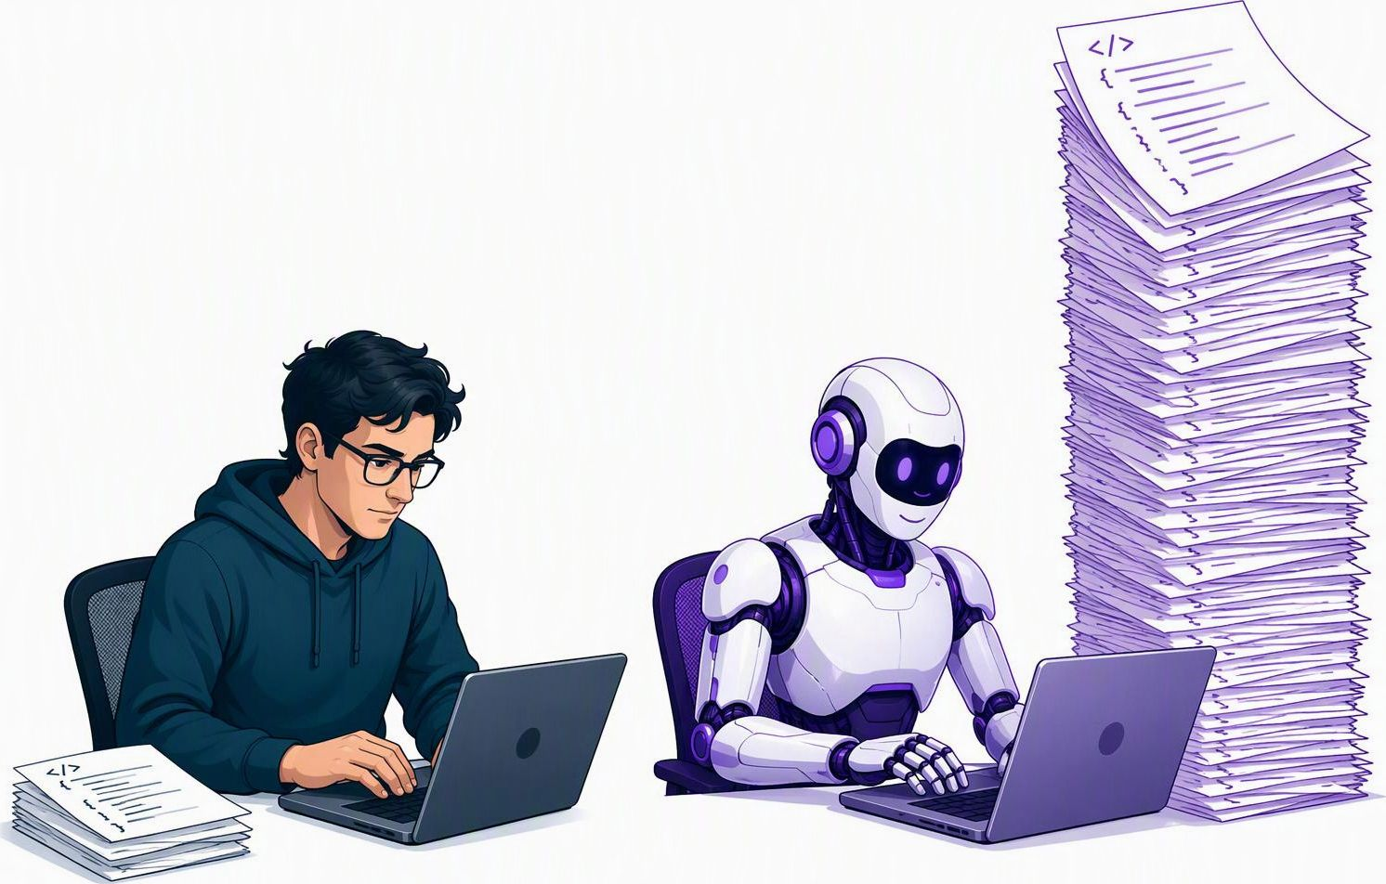
1.1 · Code is cheap & disposable
Writing code by hand
Generating code with AI

Slide 9

1.2 · AI creates noise. We filter it.

Slide 10
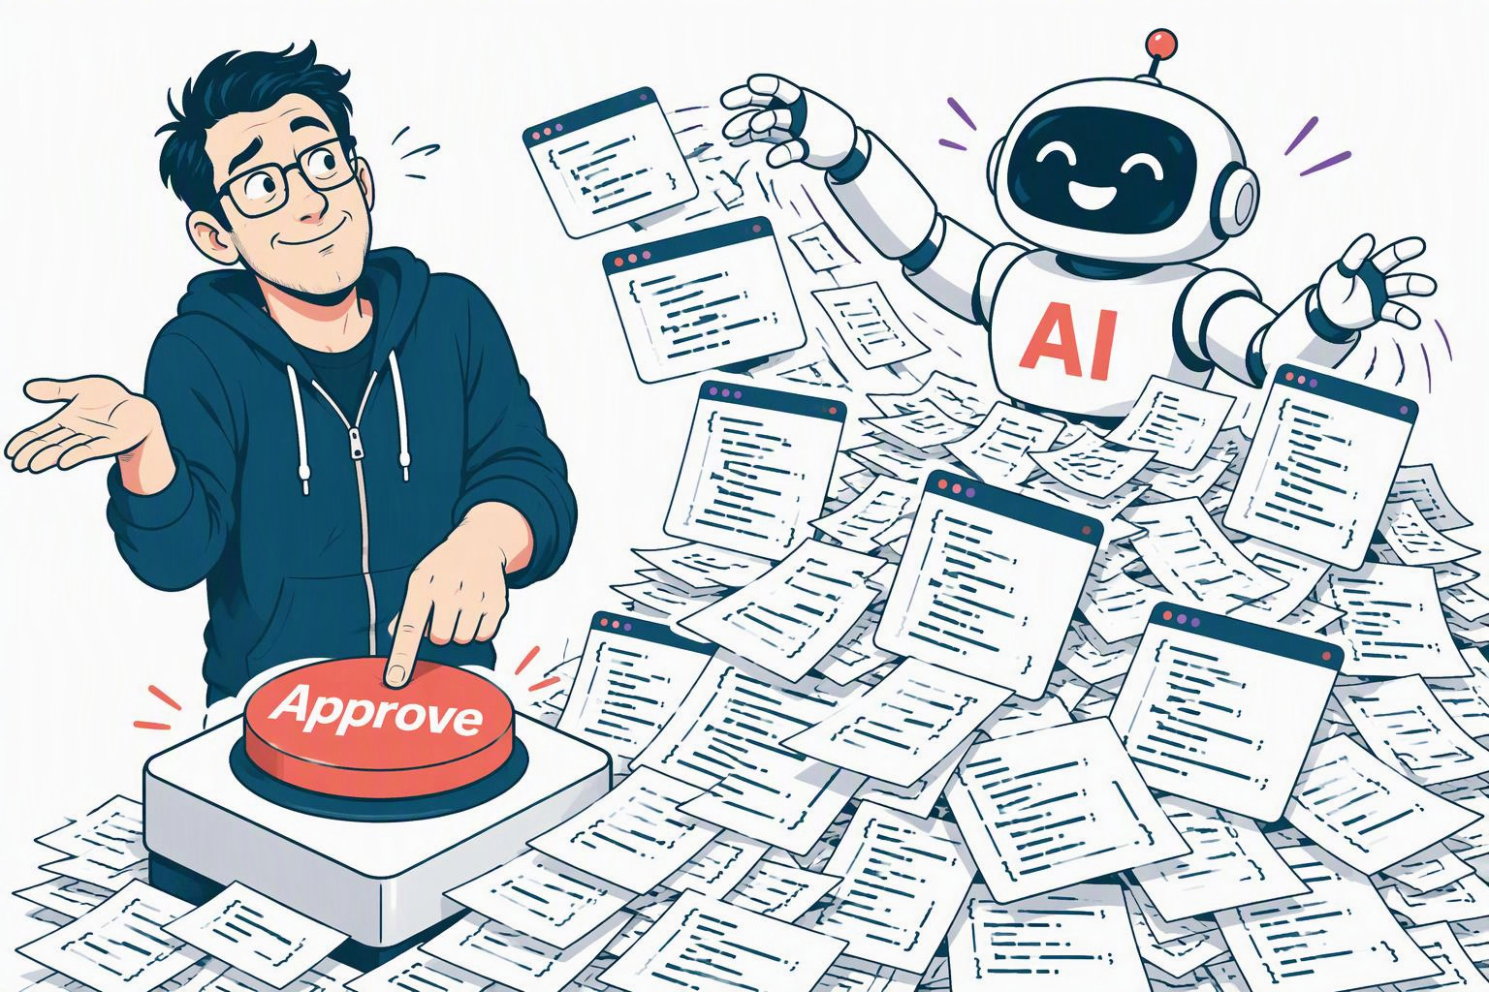
1.3 · We understand less of our code

Slide 11
1.4 · Code silently drifts from intent
Intent
Actual code

Slide 12
AI Creates. You Must Control.
✓ End of Lesson 1 · Code is cheap

Slide 13
2.1 · Natural language is now executable
▶ Lesson 2 begins · Human language is valuable
Plain
English
</>

Slide 14
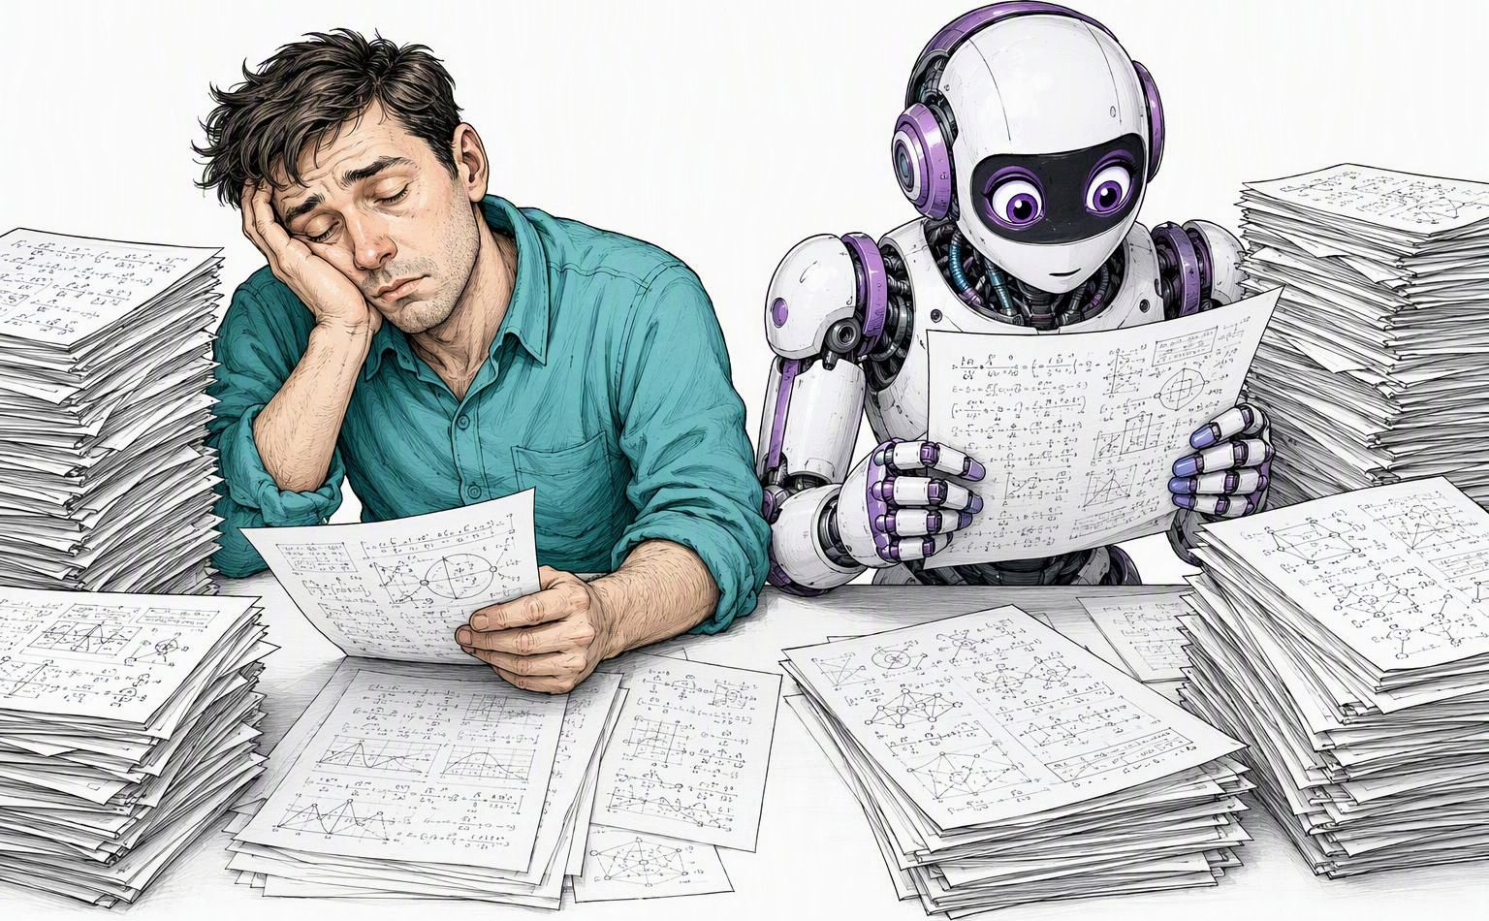
2.2 · Docs nobody read — AI reads them all

Slide 15
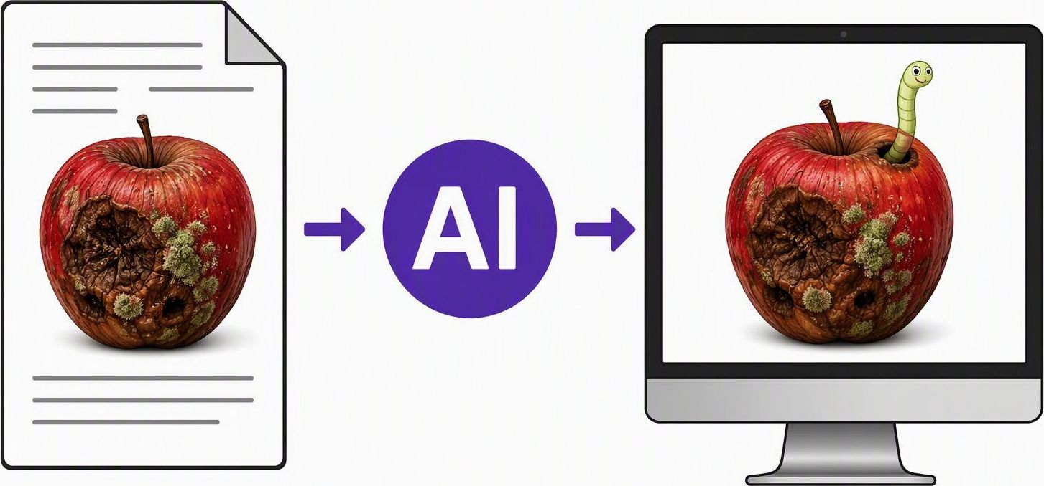
2.3 · Bad docs ruin AI results

Slide 16
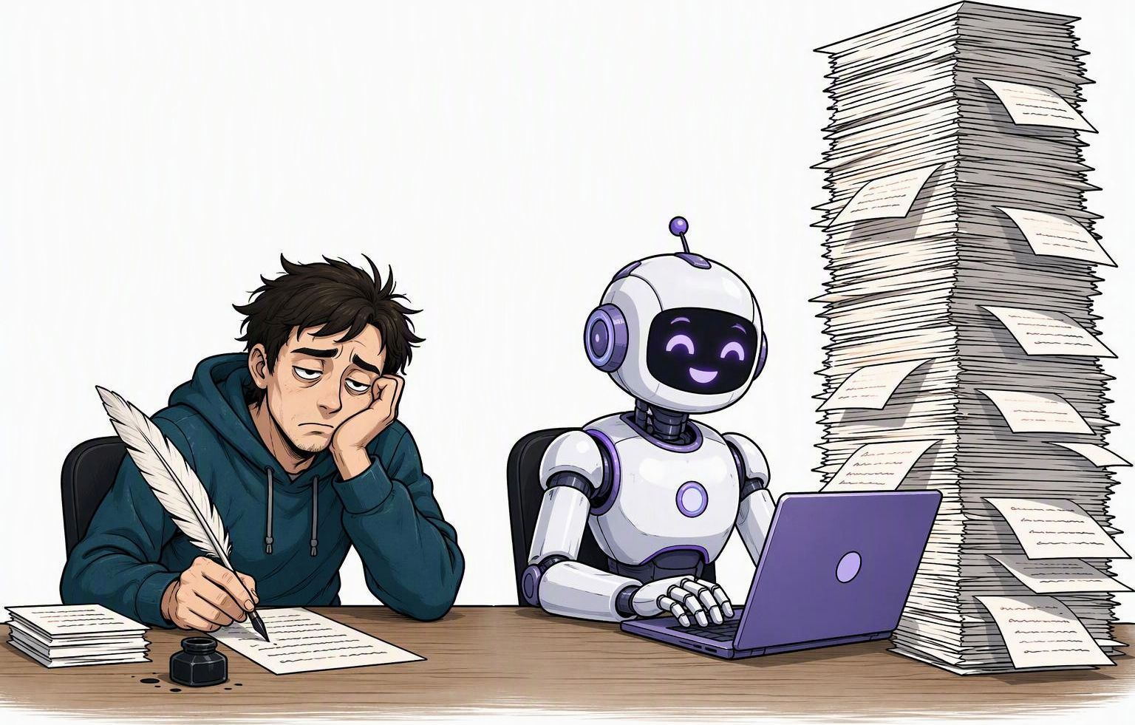
2.4 · Docs take minutes, not hours
Writing docs by hand
Generating docs with AI

Slide 17

2.5 · Docs update themselves
Code
changes
AI
Doc
updated
No manual maintenance

Slide 18
Lesson 2 summary
✓ End of Lesson 2 · Human language is valuable
Don't fear documents

Slide 19
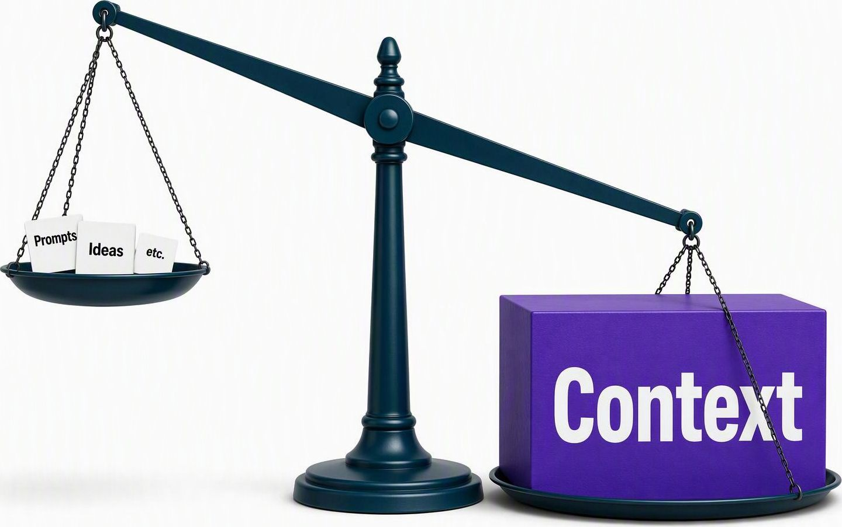
Lesson Lesson 3 · Context is critical
▶ Lesson 3 begins · Context is critical

Slide 20

3.1 · Garbage in, garbage out

Slide 21
3.2 · Bad context: incomplete
Missing

Slide 22
3.3 · Bad context: prompts contradict
Prompt #1:
"Retry 3 times"
Prompt #7:
"Never retry"
(illustrative)

Slide 23
3.4 · Bad context: prompt ≠ actual code
Prompt assumes:
sync API
Code reality:
async queue
≠

Slide 24
Lesson 3 summary
✓ End of Lesson 3 · Context is critical

Slide 25

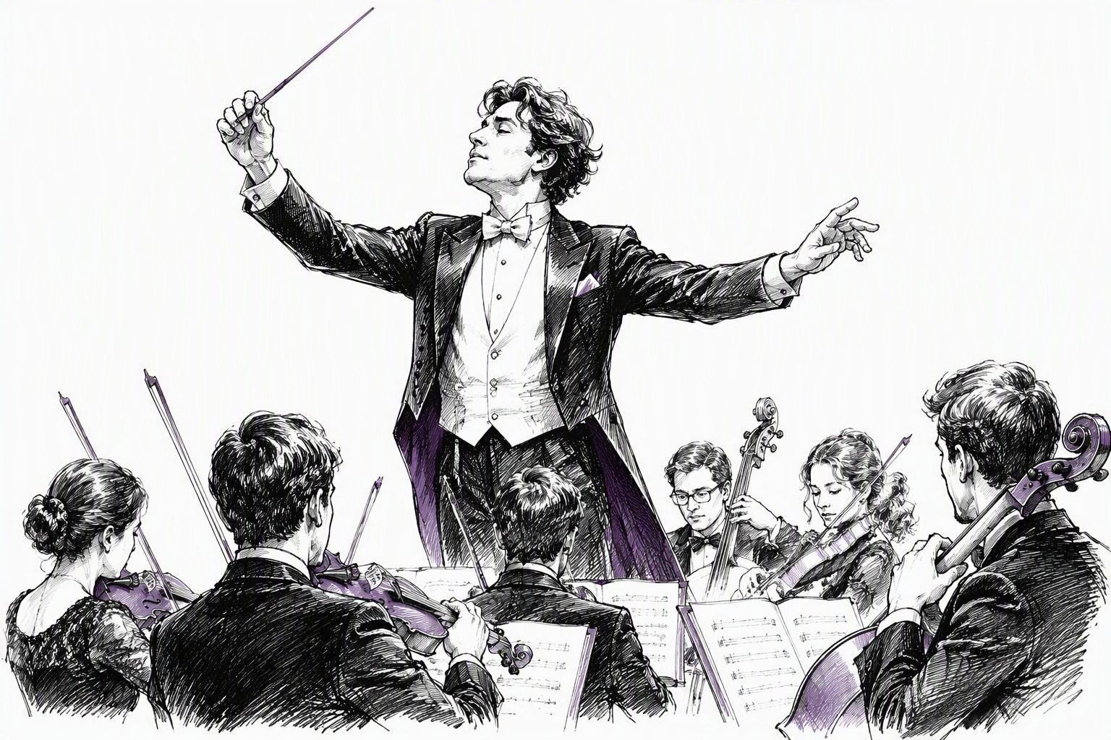
The SWE role: Implementor → Orchestrator
Implementor
Orchestrator

Slide 26

Many prompts. Many directions.

Slide 27

One spec. One direction.

Slide 28
How do we control this machine — easily?

Slide 29
Part 1.5
Meet our SDLC agent

Slide 30
Meet the SDLC agent
Source
code
Mission-Brief.md
SDLC
Agent
FSD
Plan.md
Your
directions

Slide 31
Specs drive everything
Source code
Mission-Brief.md
Unit tests
Plan.md
Updated spec
You

Slide 32
Part 2
Mission-Brief.md

Slide 33
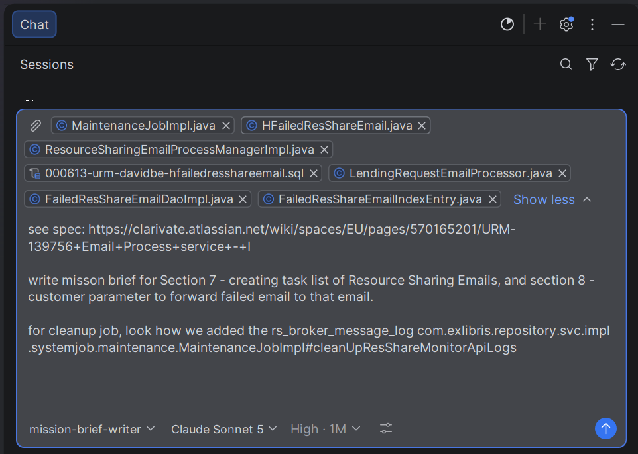
Step 1 · Select the agent
Screenshot 1
Paste screenshot here

Slide 34
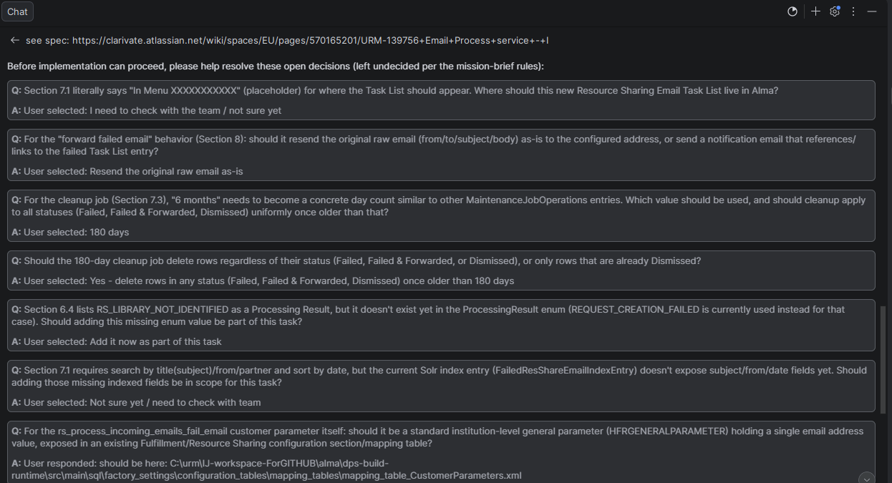
Step 2 · Answer the questions
Screenshot 3
Paste screenshot here

Slide 35
Mission-Brief.md
Live demo: Mission-Brief.md in VS Code
Presenter: pause and open the file

Slide 36
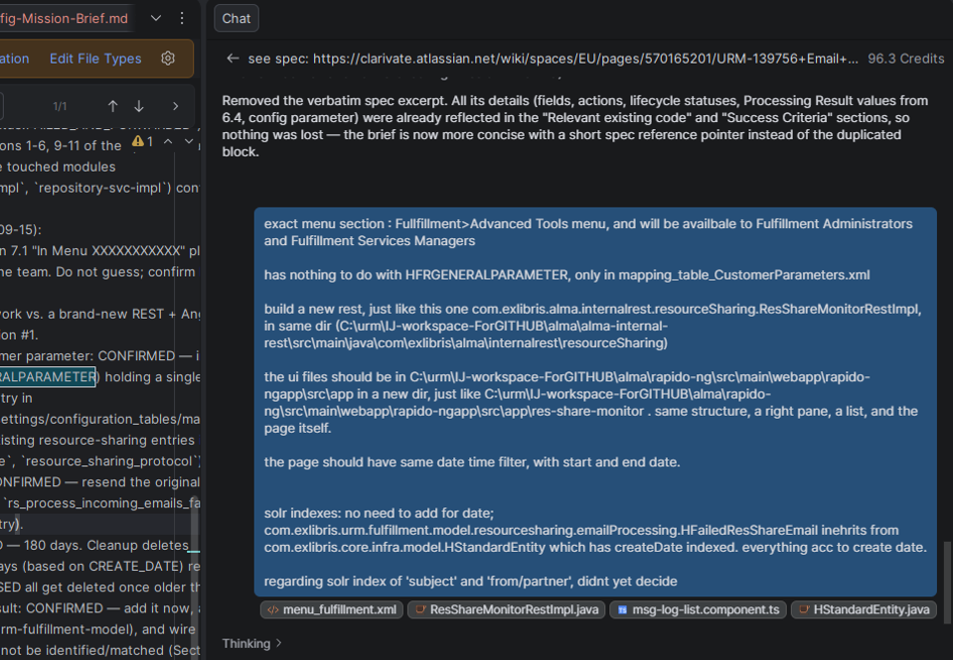
Step 3 · Review
Screenshot 4
Paste screenshot here

Slide 37
Why a Mission Brief?
This is cool!
1
2
3
4
Single source of truth
You stay in control
No repeating context
Built as one whole, not fragments

Slide 38
Mission Brief vs. FSD
 | FSD | Mission Brief
For | Product | Engineers
Grounded in code | ✗ | ✓
Kept up to date | Rarely | With every change
Lives in | Confluence… | Repo / IDE
Maybe merged someday. For now: Mission Briefs.

Slide 39
Part 3
Plan.md

Slide 40
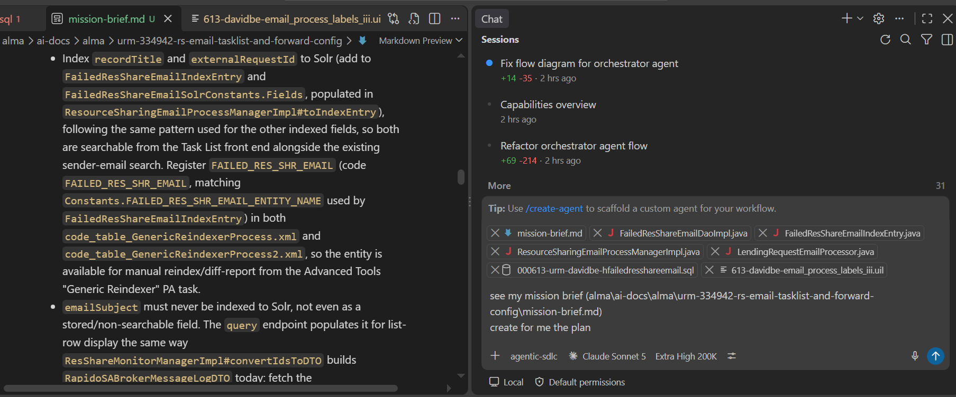
New chat. Clean context.
Screenshot 5
Open a NEW chat — let the AI think again

Slide 41
Anatomy of Plan.md
Phases
Sync / Async tasks
Exact code references

Slide 42
Plan.md
Show Plan.md
Presenter: open in VS Code

Slide 43
Why both files?
Mission-Brief.md
Plan.md
WHAT & WHY
HOW & WHEN
Overview
Details
* A company choice — just be consistent !

Slide 44
Plan.md makes PRs clear
✓
Phase 1
Pull Request
Done vs. not done
✓
Phase 2
✓
Phase 3
✗
Phase 4

Slide 45
Remember
Changed Plan.md?
Update Mission-Brief.md !!

Slide 46
Remember
Changed Mission-Brief.md?
Update Plan.md!!

Slide 47
Remember
Changed Source Code?
Update Mission-Brief
+ Plan.md!!

Slide 48

Remember
KEEP THESE .MD FILES
IN ANY NEW CONTEXT !!
That’s the whole point

Slide 49
Summary: Mission-Brief.md vs. Plan.md
 | Mission-Brief.md | Plan.md
Answers | What & why | How & when
Level | Feature | Tasks & code
Changes | Depends | Almost always
Lives in | Repo | Repo

Slide 50
Part 4
Why is this worth it?
"David, I have no power to write these documents!"

Slide 51


Less writing, not more
I’m doing this dev… do task A
Entire dev and details
Mission-brief.md
plan.md
I’m doing this dev… do task B
do task A
I’m doing this dev… do task C
do task B
do task C
Ad-hoc prompting
Spec-driven

Slide 52
AI · Data science · Copilot: same rule
AI
Data science
Copilot

Slide 53
incomplete context
ai ‘mistake’
contradictory prompt
forget about part I
of dev

Slide 54


help LLM's help each other

Slide 55
Write .md files in VS Code
Screenshot: VS Code — .md editor + preview
Paste screenshot here

Slide 56
This is the industry standard
265K+
141K ☆
Jul 2025
devs/month on OpenSpec
GitHub Spec Kit
AWS Kiro
A new spec created every 2 seconds
141K GitHub stars
12.6K forks
IDE with a built-in Spec mode
Sources: openspec.dev; github.com/github/spec-kit (accessed 14 Oct 2026); kiro.dev
Notes:
[Sources]
https://github.com/github/spec-kit
Official repository search snapshot accessed 14 October 2026 shows 141k stars and 12.6k forks. Rounded counts reflect community interest and reuse, not verified active users or quantified productivity gains.
[/Sources]

Slide 57

"I'm happy as I am. Why change?"
1 sprint
Embrace change. Just try it.
“למה משה ואהרן תפריעו את העם ממעשיו“?

Slide 59

The SWE we knew is gone
Product
Technical writer
QA
Let's practice
acceptance
You

Slide 60
Part 5
Coming soon

Slide 61
Meet our agent
Show flow-diagram.md in VS Code
Presenter: open the file

Slide 62
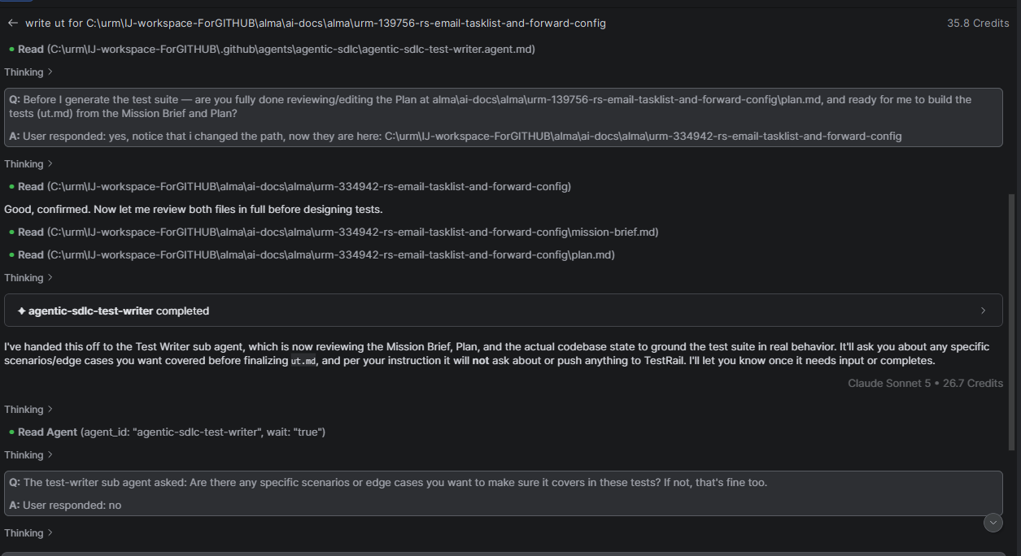
Agent steps in practice
Screenshot 8
Paste screenshot here

Slide 63
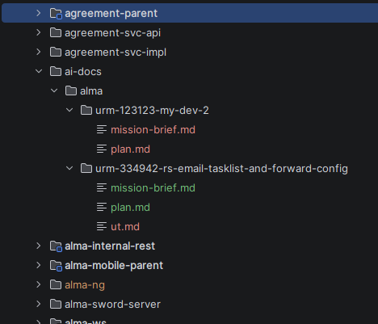
Directory output
Screenshot 9
Paste screenshot here
Next step: push to GitHub

Slide 64

Pull Requests are so clear!
“On this PR,
i did phase 2
- see commits on plan.md”

Slide 65
End of dev – how do mission-brief.md and plan.md look?
Show mission-brief.md + plan.md

Slide 66

Adoption of Spec-driven development
Document Fixes on previous dev
Skills tell agents to consult docs before changing things
Product uses docs
Technical writers use docs
QA uses docs
etc…

Slide 67
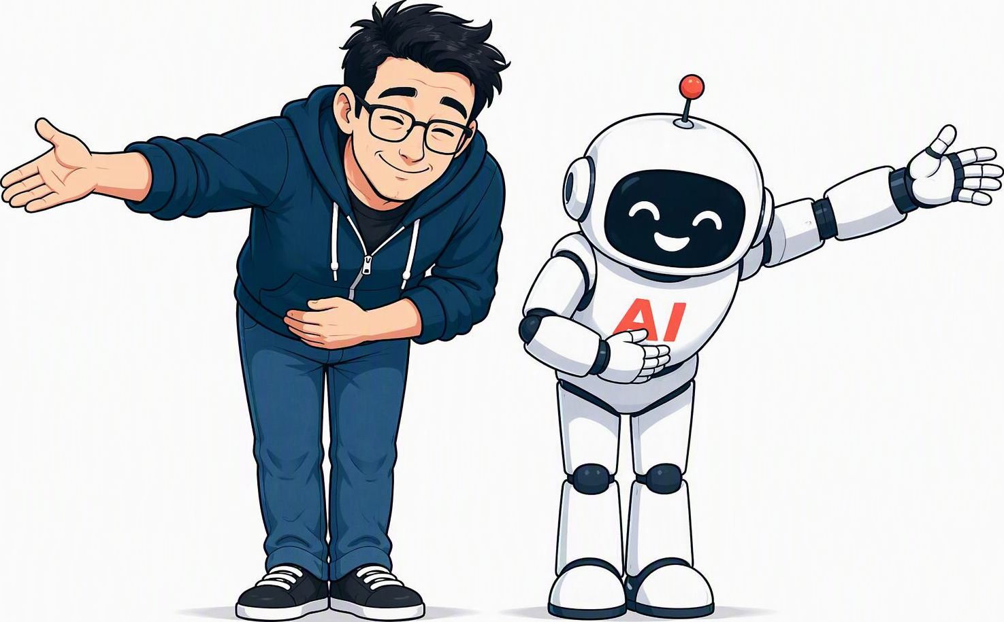




Thank you for listening!

